Slide 1
SKITZA CORP

Slide 2

COMPOUND SYSTEM in ump

Slide 3
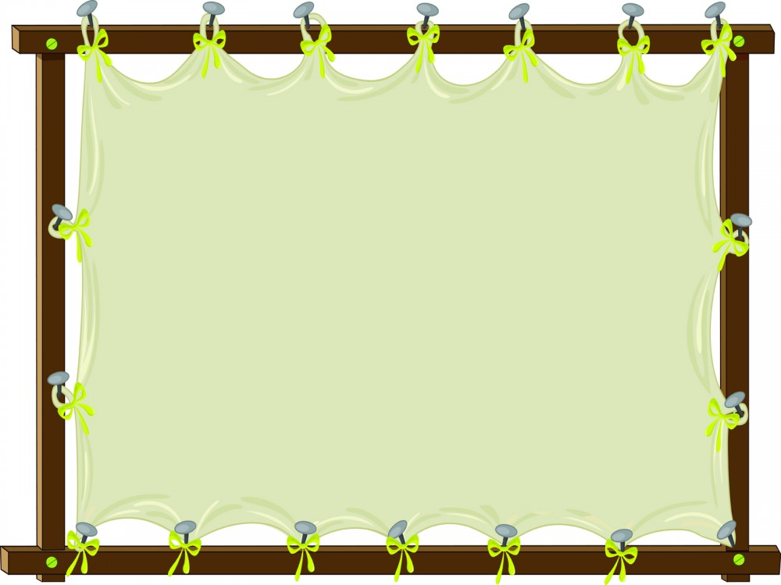
Project Manager
NORUL HUSNA BINTI OTHMAN Business Analysis
NUR SYUHAIDAH BINTI ISMAIL
Software Designer
GRACE SHEELA MOGAN
Software Developer
KAMAL WAL MUKAMMAL BIN ABD RAHIM
Quality Assurance Manager
QATHRATUN NADA BINTI ALI

Slide 4

Use Case Diagram

Slide 5
Actor involve:
Student
Felo
Treasurer
Principal
Head of principal

Slide 6
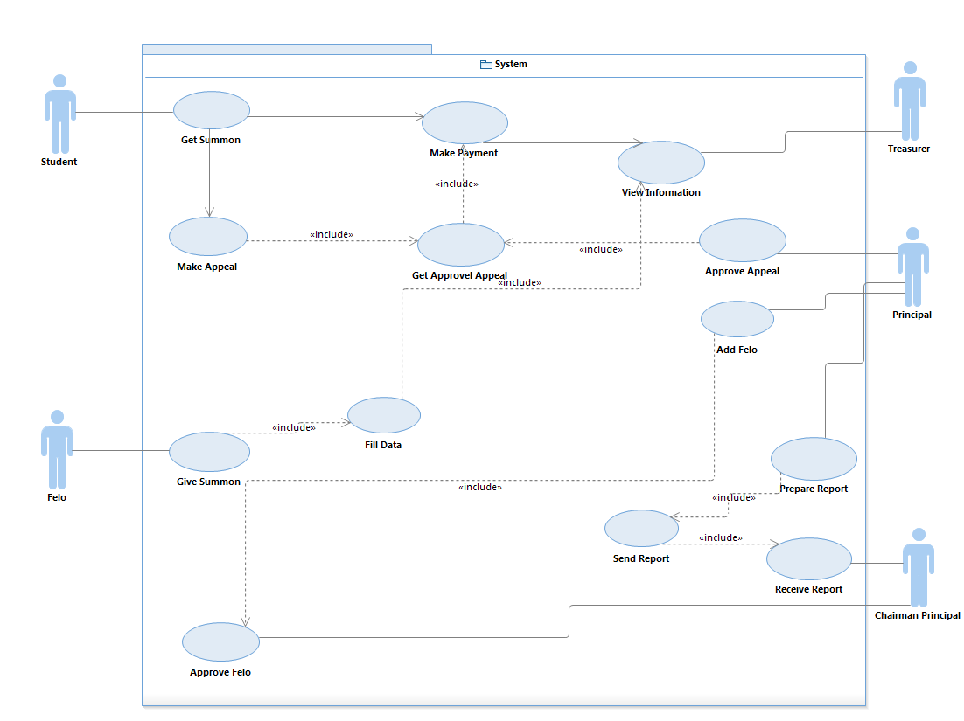

Slide 7
Sequence Diagram

Slide 8
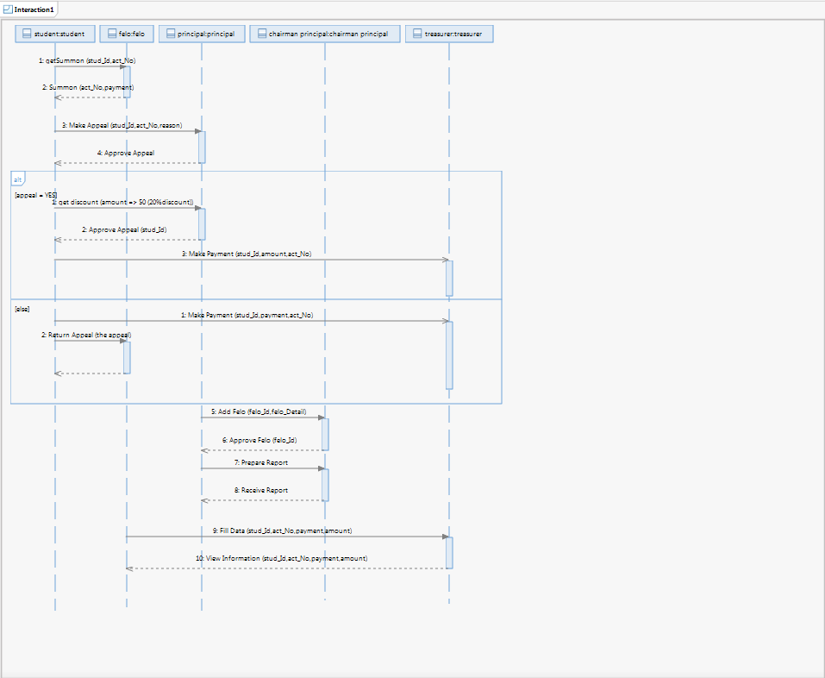
0………………………………………

Slide 9
THE END

